Slide 1
Physics-362 Final: FRACTALS: Julia & MAndLEBROT SETS
BY JAMES QUACH
12/16/2015

Slide 2
What are Fractals:
A Fractal is rough geometric shape and phenomenon that exhibits a repeating pattern at virtually every scale. This phenomenon is also known as self-similar pattern.

Slide 3
Recursion:
All types and forms of fractals follow a mathematically recursive pattern.
Recursion is a process in which something repeats itself in a self-similar way.
Recursive patterns can be defined by two properties in mathematics/computer-science:
1. Base Case(s): Starting Point
2. Set of conditions that reduces all other cases to the base case.
A well known example of recursion is the Fibonacci Sequence:

Slide 4
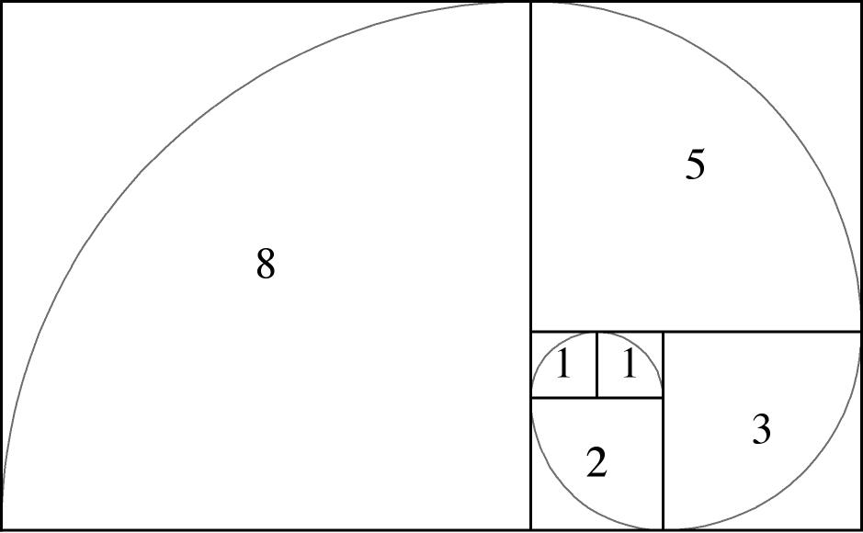
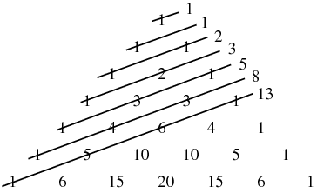
Recursion:Fibonacci Sequence:
Pseudocode:
f(0)= 0; //as base case 1;
f(1) = 1; //as base case 2;
For (n>1){
f(n)= f(n-1) + f(n-2);
}
http://thespiritscience.net/wp-content/uploads/2015/06/fibonacci_spiral.jpg
http://mathworld.wolfram.com/images/eps-gif/FibonacciShallowDiags_1000.gif

Slide 5
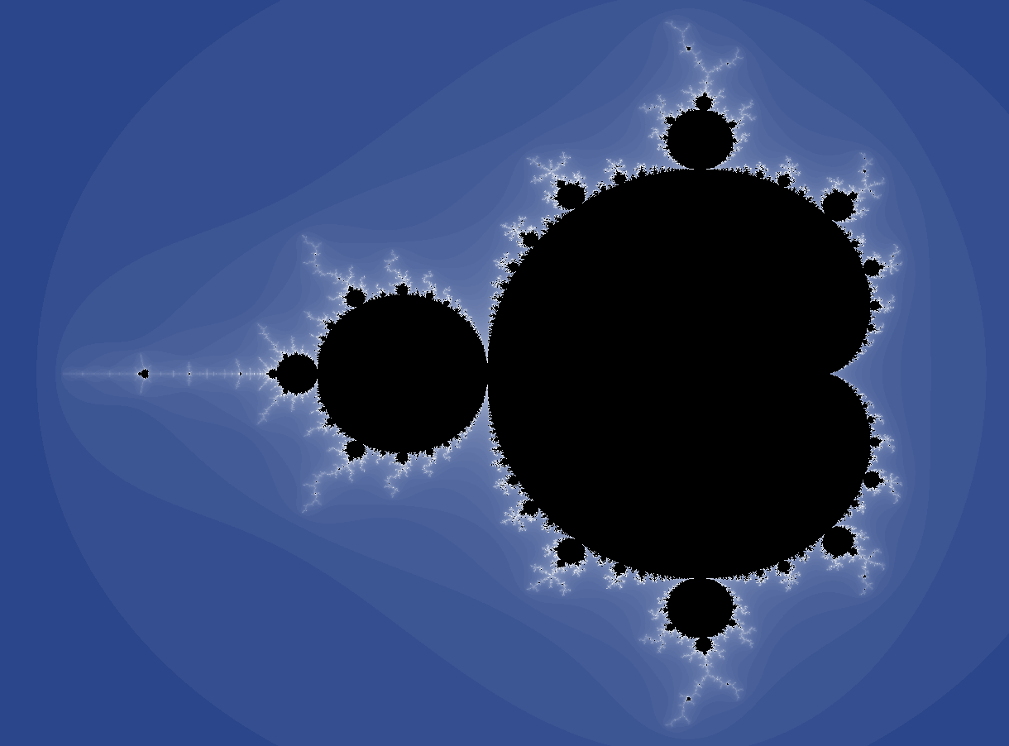
Mandelbrot Sets:
Mandelbrot sets are a set of complex numbers c for which sequences (c,c^2 + c, (c^2 +c)^2 + c,........) doesn't approach infinity.
The Mandelbrot set can be represented by the polynomial
z(0) = z, z(n+1) = z(n)*z(n) + z, n=0,1,2,... ...
http://www.math.utah.edu/~pa/math/mandelbrot/large.gif

Slide 6
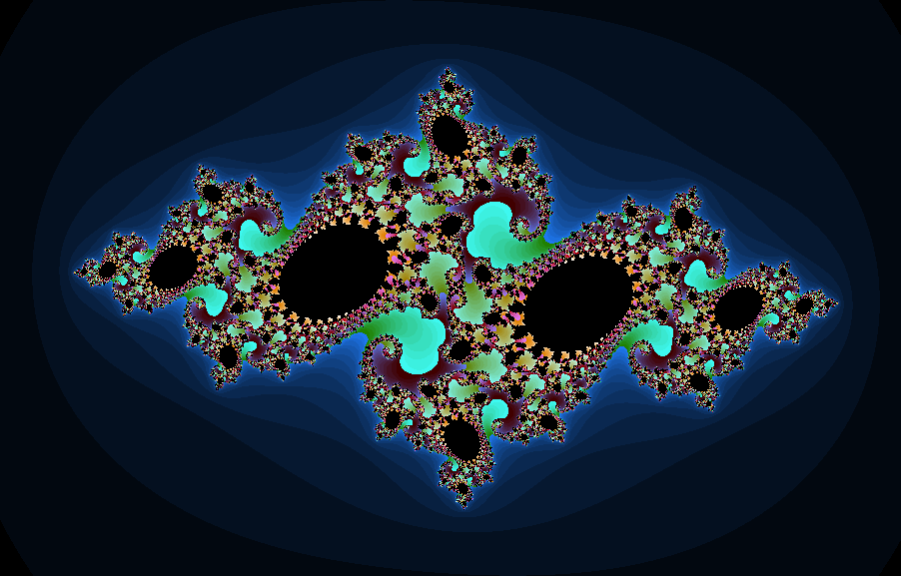
Julia Sets:
Julia set is the complement of the Mandelbrot set.
For every Mandelbrot set there is a Julia set in every point in which one were to zoom in on the Mandelbrot set.
http://www.ifp.illinois.edu/~sdickson/Julia/JuliaSlice_1K.png

Slide 7
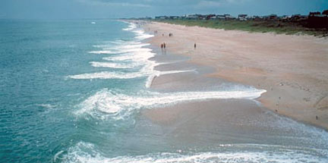
Fractals in Nature: Coastlines
Natural terrain such as coastlines, mountains, etc are neither straight or of a generic shape but can be approximated as fractal in shape.
http://www.whoi.edu/cms/images/shorelinechange_main_205593.jpeg

Slide 8
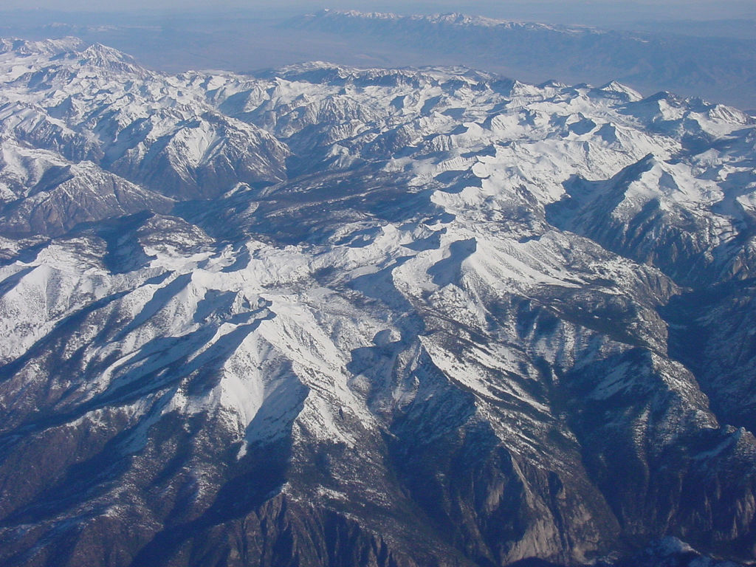
Fractals in Nature: MOUNTAINS/Plate-tectonics
As a result of tectonic plates colliding with one another, parts of the Earth's crust pushes upward by the path of least resistance resulting in mountains.
Mountains when observed from above demonstrates neither a shape non-regular in pattern but that of a fractal pattern.
https://c1.staticflickr.com/1/21/25056176_62fd715146_b.jpg

Slide 9
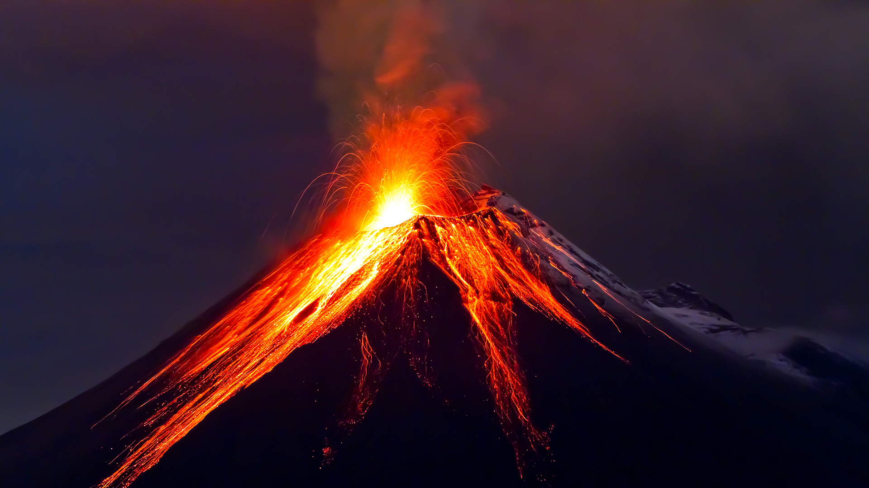
Fractals in Nature: Volcanos/PLATE TECTONICS
Due to tectonic plates diverging or converging, rifts form from the Earth's Crust comes gushing with lava, ash, and smoke debris. This is known as a volcanic eruption that forms volcanos.
The eruptions from the rupture of the Earth's Crust causes fragmentations that are fractal in shape.
http://www.citiesonvolcanoes5.com/wp-content/uploads/2015/09/3023455-poster-p-volcano_0.jpg

Slide 10
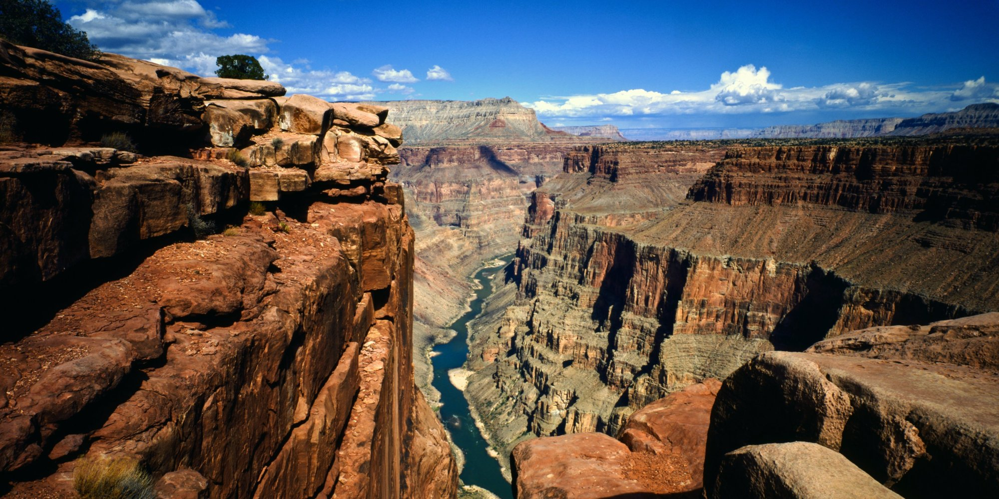
Fractals in Nature: Canyons
Due to over long periods of time from soil erosions, Ravines form from a plateau resulting in formations known as canyons and they are fractals in shape.
http://i.huffpost.com/gen/1585786/images/o-GRAND-CANYON-RIVER-facebook.jpg

Slide 11
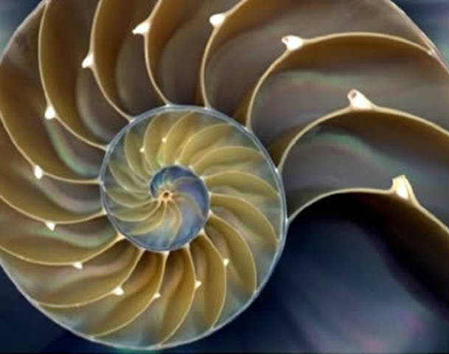
Fractals in Nature: SPIRAL SHELLS
In shells, the repeating spiral shape of seashells demonstrates a fractal pattern that is ever expanding as the shell spirals outward.
https://s-media-cache-ak0.pinimg.com/236x/38/0e/97/380e97865083f64e970761ee83c80d74.jpg

Slide 12
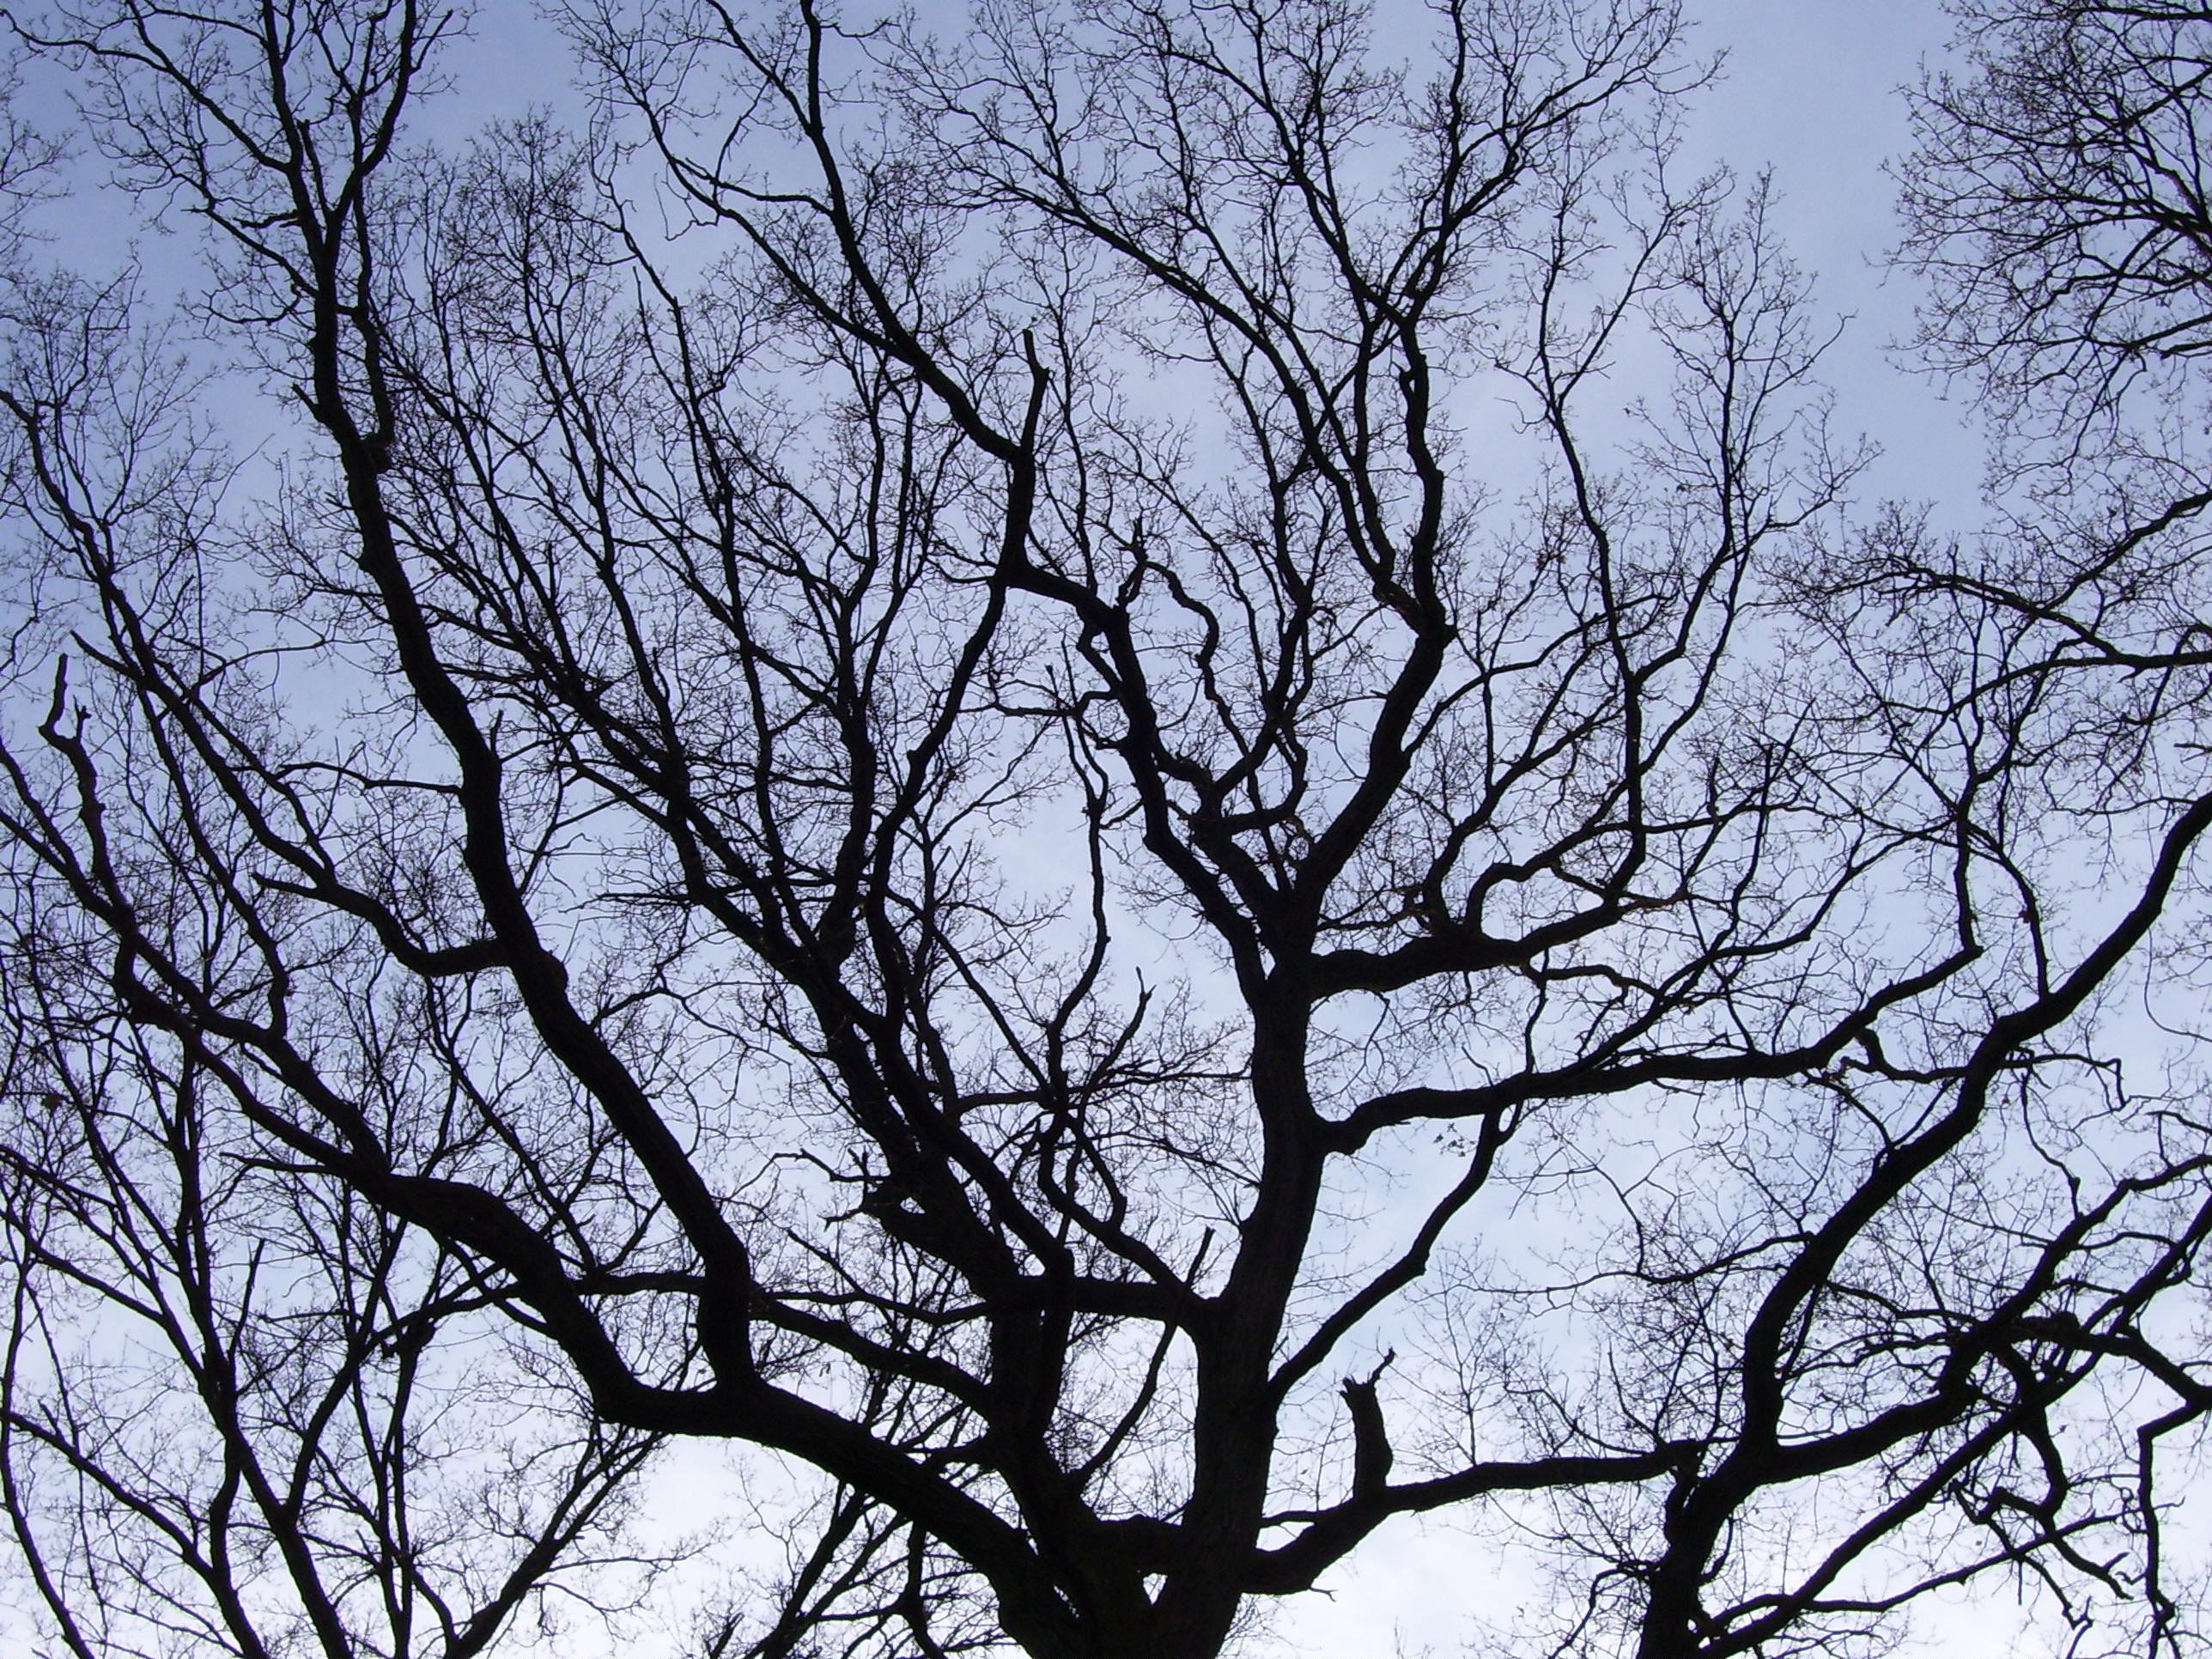
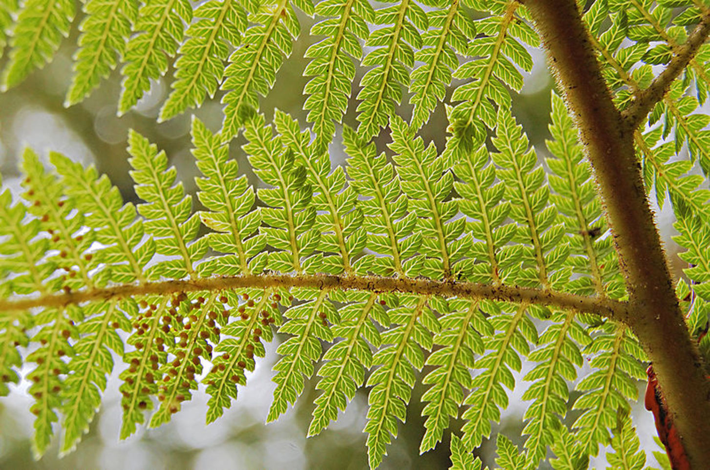
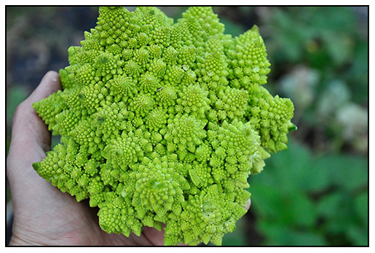
Fractals in Nature: plants
The Plant Kingdom happens to have a lot of species that have fractal patterns in them. Obvious ones are trees, leaves and also broccoli.
https://upload.wikimedia.org/wikipedia/commons/4/42/Branches_of_a_tree.JPG
https://62e528761d0685343e1c-f3d1b99a743ffa4142d9d7f1978d9686.ssl.cf2.rackcdn.com/files/18022/area14mp/2qxdx8s5-1353973852.jpg
http://www.backyarddiva.ca/wp-content/uploads/2014/01/romanesco.jpg

Slide 13
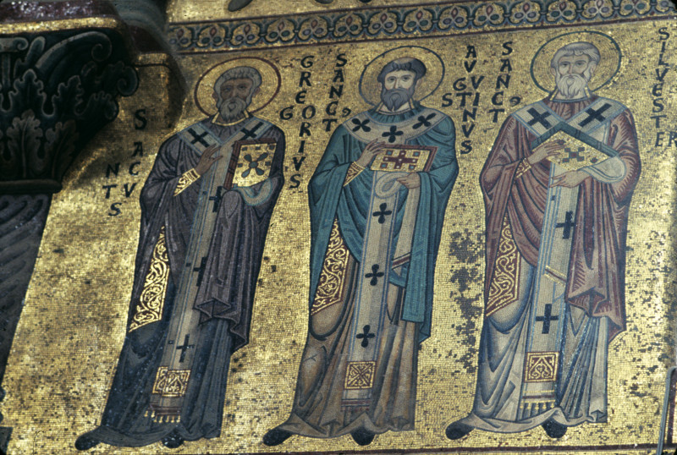
APPLICATIONS of FRACTALS: ART
Fractals happen to have many applications in real life. Art is by far the most obvious one. Fractal patterns are used and to make beautiful works of art throughout the ages. One such example is the use of mosaics as shown on the right.
http://etc.usf.edu/clippix/pix/Cefal-cathedral-mosaics-north-wall-of-choir-Sts-Gregory-Augustine-and-Silvester_medium.jpg

Slide 14
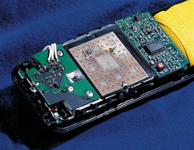
APPLICATIONS of FRACTALS: Fractal attenae
The shape of fractals are what makes the antennae of wireless devices such as cellphones, laptops, and etc to possibly communicate wirelessly.
It is the self-similar shape of the antenna that allows it to function invariant of antenna frequency and bandwidth.
http://fractalfoundation.org/OFCA/cell_antenna.jpg

Slide 15
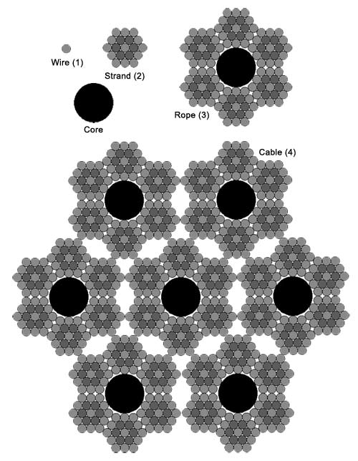
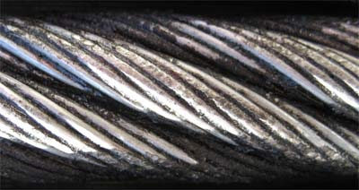
APPLICATIONS of FRACTALS: SUSPENSION Cables
In modern suspension bridges, steel cables that suspend the bridge are consisted of repetitive strands of cable wrapped in a spiral increases the tensile strength of the cable. This allows the suspension bridge to bear a much greater payload.
http://fractalfoundation.org/OFCA/CableFractal.jpg
http://fractalfoundation.org/OFCA/WireRope.jpg

Slide 16
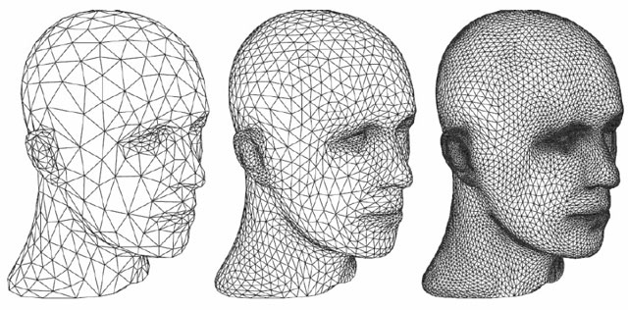
APPLICATIONS of FRACTALS: COMPUTER GRAPHICS
The use of fractals in graphics algorithms generates greater samples of smaller polygons out of subdividing larger polygons by tiling. This effect is known as Tessellation.
The greater amount of sampling helps improves the smoothness of the surface of an rendered object and enhances photorealism.
https://qph.is.quoracdn.net/main-qimg-67fe1eb1fd7eb2fe7b297080333af8b1?convert_to_webp=true

Slide 17
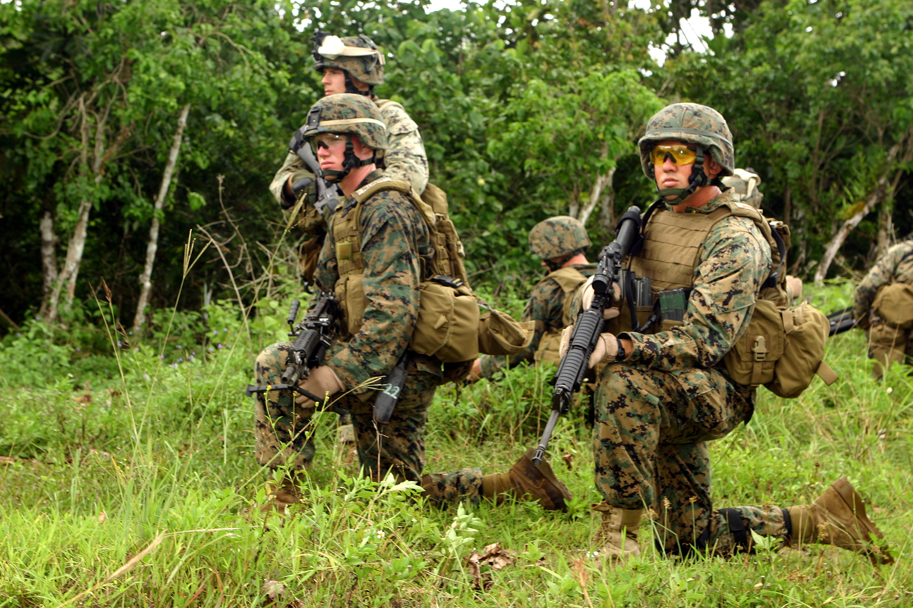
APPLICATIONS of FRACTALS: Digital Camouflage uniforms
The use of fractals in digital camouflage uniforms have aided in provided a greater concealment within the respective environment than that of earlier uniforms in the past. This in turn provides greater survivability in the battlefield.
https://upload.wikimedia.org/wikipedia/commons/9/9e/Marines_MARPAT.JPG

Slide 18
CONCLUSION:
Fractals are a rough geometric shape and phenomenon that exhibits a repeating pattern at virtually every scale. This phenomenon is also known as a self-similar pattern. Fractal patterns have been found almost everywhere in nature, and have profound applications in art, science and technology alike. Fractals have been a fascinating subject for me to study as a final research project topic.

Slide 19
References:
Alfred, P. (1998, August 10). The Mandelbrot Set. Retrieved from http://www.math.utah.edu/~pa/math/mandelbrot/mandelbrot.html
Barnsley, M., & Rising, H. (1993). Fractals everywhere (2nd ed.). San Diego, Calif.: Academic Press. https://books.google.com/books/about/Fractals_Everywhere.html?id=9nwoOLOMhRAC&printsec=frontcover&source=kp_read_button&hl=en#v=onepage&q&f=false
Dickson, S. (n.d.). 4D Zoetrope of the Quaternion Julia Set. Retrieved December 9, 2015, from http://www.ifp.illinois.edu/~sdickson/Julia/Zoetrope3.html
Fowler, D., Meinhardt, H., & Prusinkiewicz, P. (1992). Modeling Seashells, 10-10. From http://algorithmicbotany.org/papers/shells.sig92.pdf
Fractal Applications- Cables and Bridges. (n.d.). Retrieved from http://fractalfoundation.org/OFC/OFC-12-1.html
Fractal Art: Beauty and Mathematics - Mathematical Imagery Presented by the American Mathematical Society (Fractal Art: Beauty and Mathematics - Mathematical Imagery Presented by the American Mathematical Society)
http://www.ams.org/mathimagery/thumbnails.php?album=13
Gusev, A. (2014). The fractal structure of the sequence of volcanic eruptions worldwide: Order clustering of events and episodic discharge of material. J. Volcanolog. Seismol. Journal of Volcanology and Seismology, 34-53. Retrieved December 16, 2015, from http://link.springer.com/article/10.1134%2FS0742046314010023#page-1
Hohlfeld, Robert G.; Cohen, Nathan (1999). "Self-similarity and the geometric requirements for frequency independence in Antennae".Fractals 7 (1): 79–84. doi:10.1142/S0218348X99000098
Joyce, D. (2003). Julia and Mandelbrot Sets. Retrieved November 30, 2015, from http://aleph0.clarku.edu/~djoyce/julia/julia.html
O'Neill, T., & Cramer, G. (2005). The Science of Digital Camouflage Design. Retrieved from http://hyperstealth.com/digital-design/index.htm
Prusinkiewicz, P., & Lindenmayer, A. (2004). Chapter 8 - Fractal properties of plants. In The Algorithmic Beauty of Plants (pp. 175-190). New York: Springer-Verlag. http://algorithmicbotany.org/papers/abop/abop-ch8.pdf
Tariq, Sara.(2009). "D3D11 Tessellation" (PDF). Nvidia. http://developer.download.nvidia.com/presentations/2009/GDC/GDC09_D3D11Tessellation.pdf
Turcotte, D. (1991). Fractals in geology: What are they and what are they good for? 1, 1-4. Retrieved from http://www.geosociety.org/gsatoday/archive/1/1/pdf/i1052-5173-1-1-sci.pdf

